Slide 1


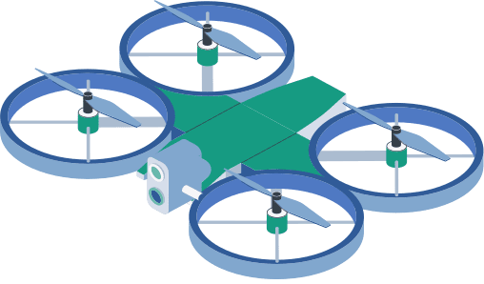


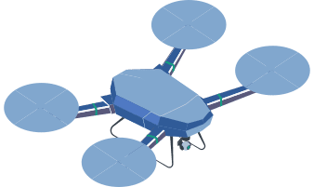



Visual-Based Navigation:
Visual perception technique for autonomous systems.
MEMBERS:-
Mausumi Bhuyan(122201001)
Swadha Swaroop(112201009)
MENTOR: -
Dr. Shaikshavali Chitraganti

Slide 2
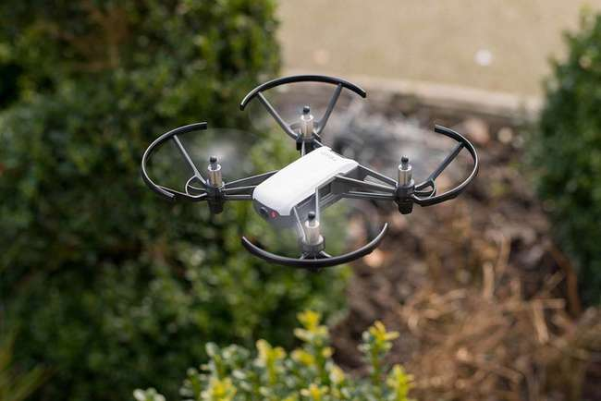
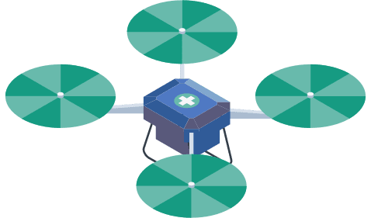

INTRODUCTION
Drones currently rely on GPS and the internet for navigation.
In military, disaster response, and space missions, GPS dependency poses risks such as signal jamming, tracking, and network failure.
This project aims to develop a vision-based algorithm that enables drones to navigate and land autonomously using image-based data.

Slide 3
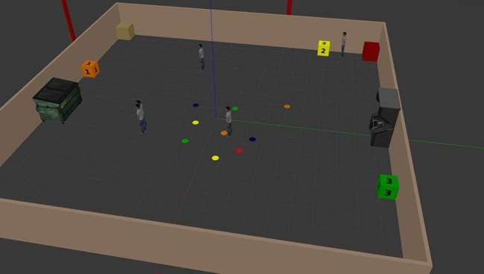

BACKGROUND AND MOTIVATION
Drones have transformed industries, from commercial applications to military and space exploration.
GPS-based navigation is effective but unreliable in hostile or remote environments due to connectivity issues and security risks.
Adversaries can intercept signals, jam networks, or track UAV movements, making autonomous navigation crucial.
A vision-based system enhances UAV autonomy, allowing reliable operation in unpredictable conditions.

Slide 4

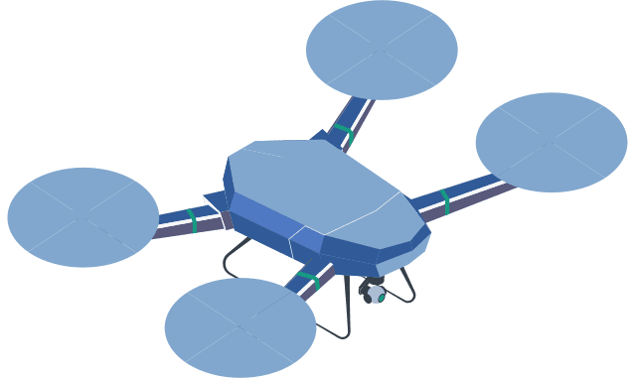

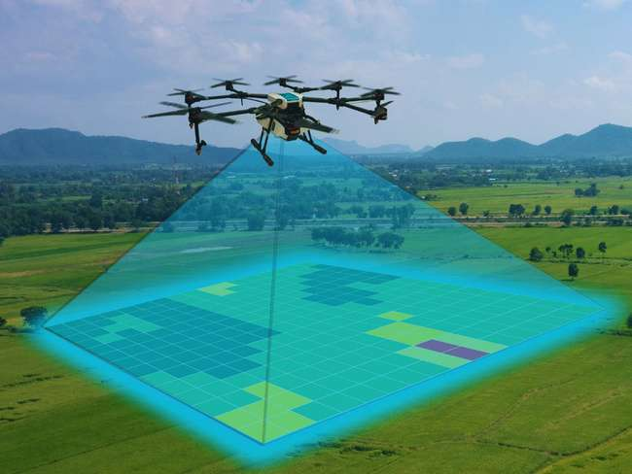
IMPORTANCE
Vision-based navigation offers greater accuracy and autonomy than GPS-dependent systems, using computer vision, AI, and feature recognition to detect landing zones and avoid obstacles. Unlike GPS, it operates independently without the risk of signal jamming or spoofing.

Slide 5

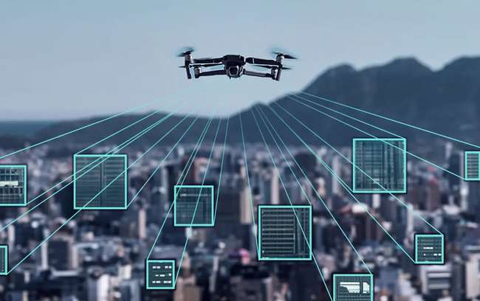
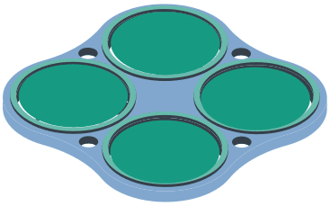

Enables stealth military missions without GPS jamming or tracking risks.
Helps drones navigate debris and urban areas for rescue missions.
Ensures precise landings in complex environments for deliveries.
Offers versatility in agriculture, surveillance, and inspections.
—SOMEONE FAMOUS

Slide 6


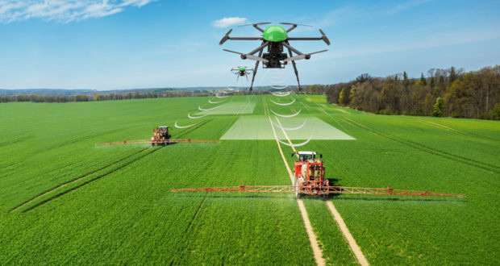
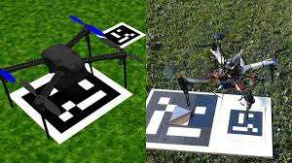

Existing Research & Technologies
Most UAVs use GPS-based navigation, but it is vulnerable to jamming and spoofing. Some drones rely on ArUco markers and GPS for precise localization, but it is costly and power-intensive.

Slide 7

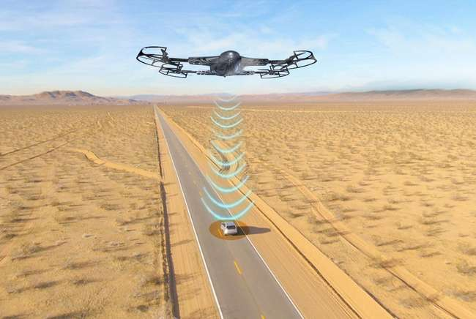


Vision-based systems, using computer vision and deep learning, are gaining popularity, with drones leveraging onboard cameras for marker detection, terrain mapping, and obstacle avoidance.
Additionally, advancements in SLAM (Simultaneous Localization and Mapping) and sensor fusion techniques enable drones to create real-time environmental maps, improving navigation in unstructured terrains.

Slide 8
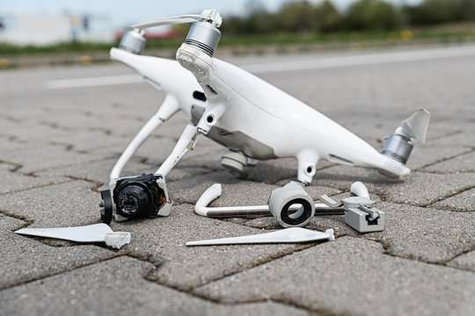
TECHNICAL CHALLENGES
Ensuring smooth and precise takeoff and landing is crucial to prevent instability, crashes, or mission failures.
GPS-based navigation is vulnerable to jamming, spoofing, and cyber-attacks, making it risky for critical missions.
UAVs must handle dynamic terrain changes, like slopes or uneven surfaces, without external guidance.

Slide 9
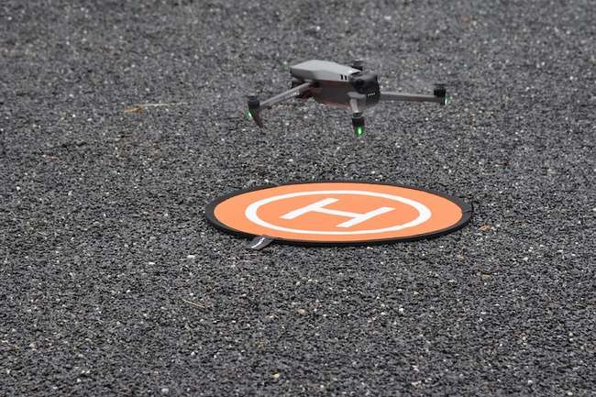
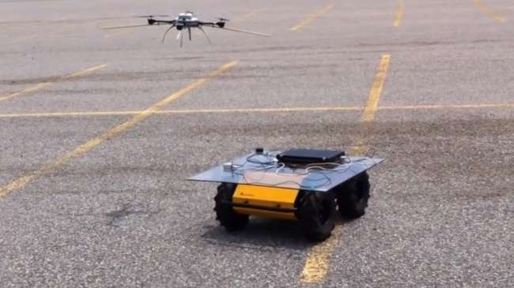
Landing without markers is a challenge, as UAVs cannot always rely on predefined visual references (such as ArUco markers).
Landing on a moving target is a complex challenge requiring real-time trajectory adjustments, predictive algorithms, and precise control to ensure safe and accurate landings.

Slide 10

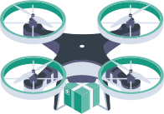

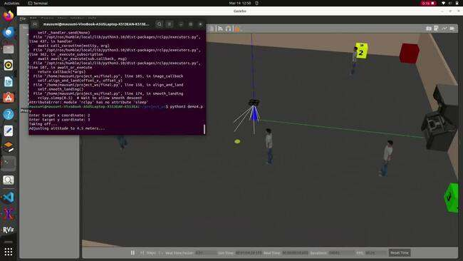
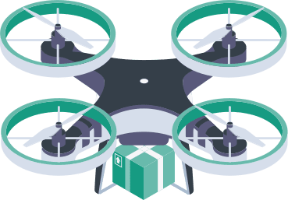
APPROACH TOWARDS SOLUTION
Currently, our lab does not have programmable drones. Although some have been purchased, their arrival has been delayed. Due to budget limitations, procuring additional drones is difficult. Therefore, we have started working with drone simulations in Gazebo.
Initial Approach:
To begin, we used a basic method with target coordinates to understand drone movement and landing:
The drone ascends to a safe height.
It moves towards the given target coordinates.
Once it reaches the target location, it lands smoothly.

Slide 11
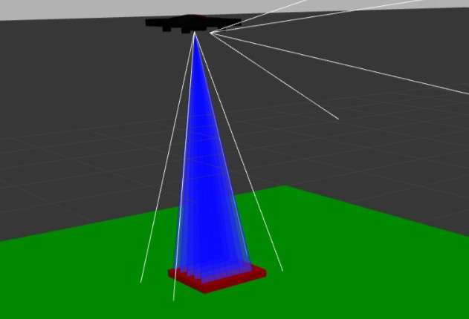




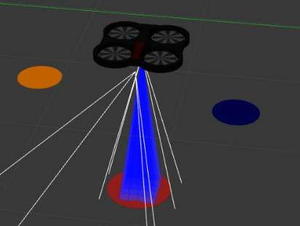




Vision-Based Navigation Using Red point as Target
Replaced fixed coordinates with an image-processing approach.
Process:
The drone ascends and initiates a square spiral search.
During the search, it continuously processes images from the bottom camera.
Instead of ArUco markers, the system detects any red-colored object as the landing target.

Slide 12
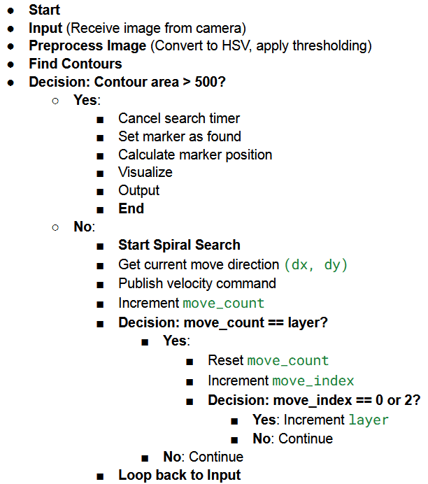
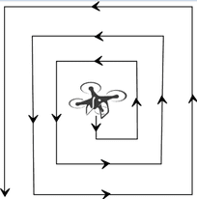

IMAGE PROCESSING AND LANDING
Search Strategy:
The drone expands its search area layer by layer in a spiral pattern.
Red object detection is done using HSV color filtering.
Detection & Landing:
Once the red marker is detected, the drone aligns itself with the marker.
It gradually descends while continuously adjusting position.
Finally, it lands precisely on the red marker.

Slide 13

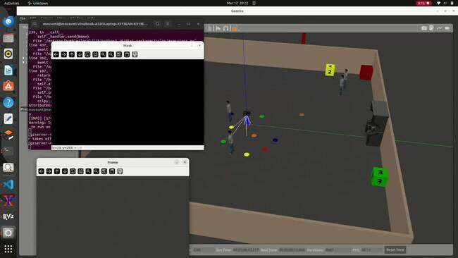


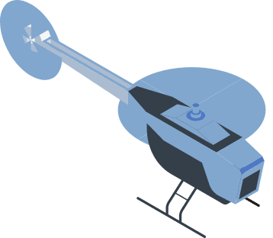

PROGRESS SO FAR

Slide 14
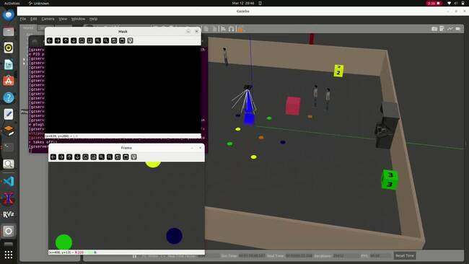
PROGRESS SO FAR

Slide 15
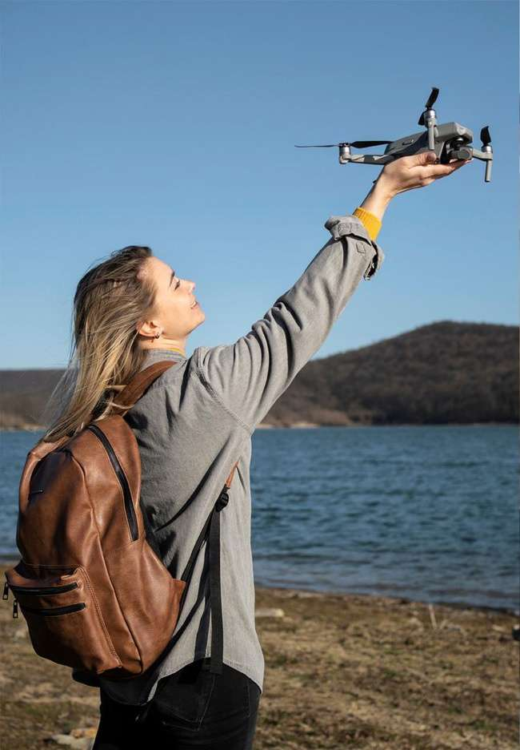
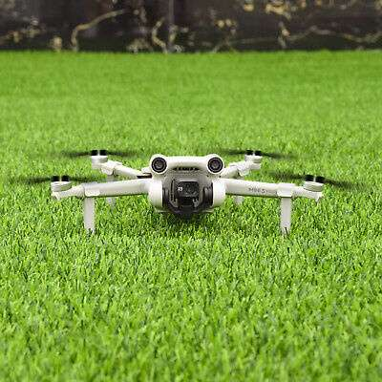
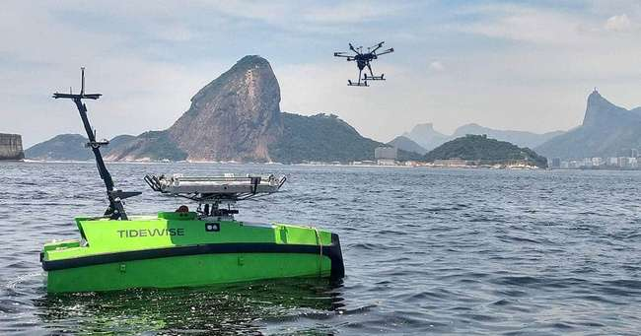

FUTURE WORK
While the current vision-based system successfully enables autonomous UAV landing in GPS-denied environments, several areas require further improvement and enhancement:
Landing Without Markers
Instead of relying on a predefined red or any other color object, UAVs can use terrain recognition and feature-based landmark detection for autonomous landing.
Real-World Testing & Deployment
Transitioning from simulation to real-world UAV testing ensures reliability in diverse environments.

